Slide 1
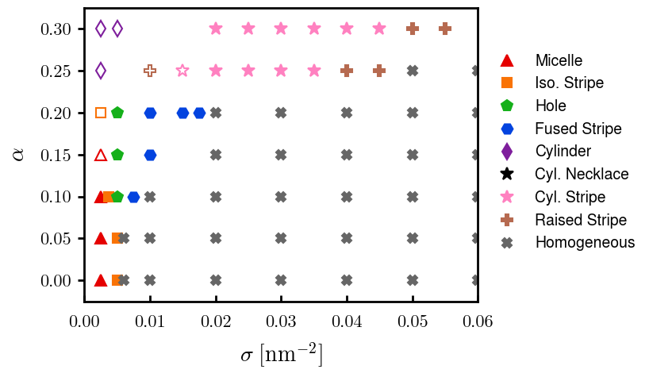
Current runs on phase diagram,
06/24
06/24
06/24

Slide 2



a00s3e3 - DONE
F= -1.77969
F = -1.77893
F= -1.77588, unstable

Slide 3










a00s5e3 - DONE
F = -2.986
F = -2.98574
F = -2.98733
F = -2.98580
F = -2.98637
F = -2.98644

Slide 4


a00s6e3 - DONE
F = -3.59170
F = -3.59404

Slide 5


a00s7e3 - DONE
F = -4.20090
F = -4.20224
Terran tried stripe (15.2, 20.2) & (12.2, 20.2). Unstable

Slide 6



a05s3e3 - DONE
F = -1.77283
F = -1.77232
F = -1.77005

Slide 7



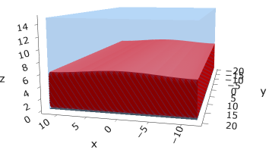
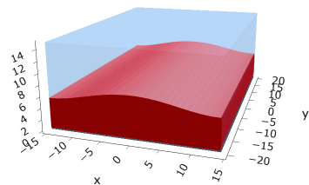
a05s5e3
F = -2.97229
F = -2.97422
F = -2.97319
F = -2.97365

Slide 8



a05s6e3 - TERRAN
F = -3.57664
F = -3.57732
F = -3.57783

Slide 9



a05s7e3 - DONE
F = -4.18090
F = -4.18116
F = -4.18226

Slide 10
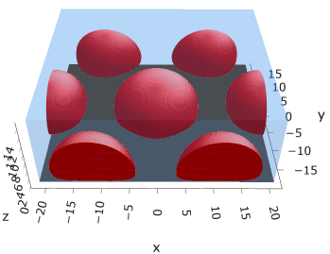
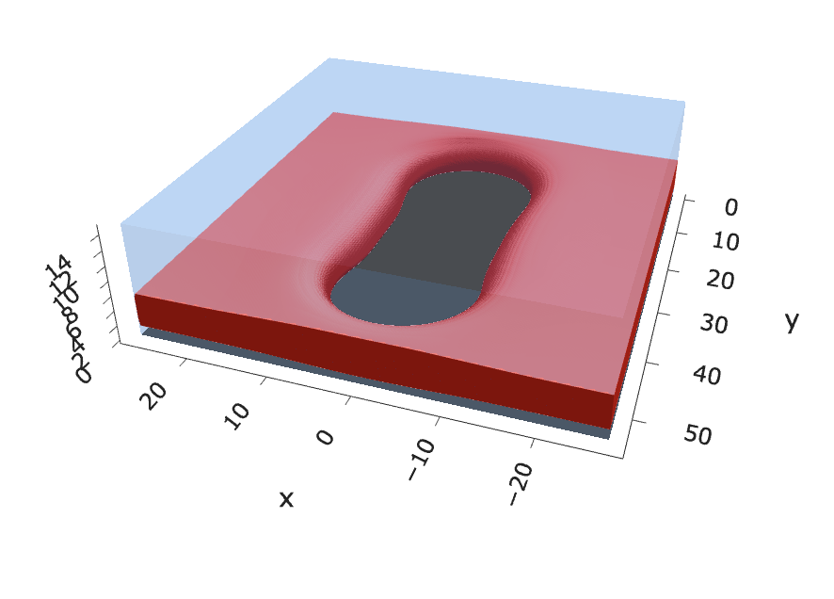
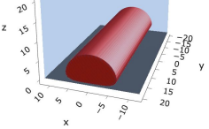
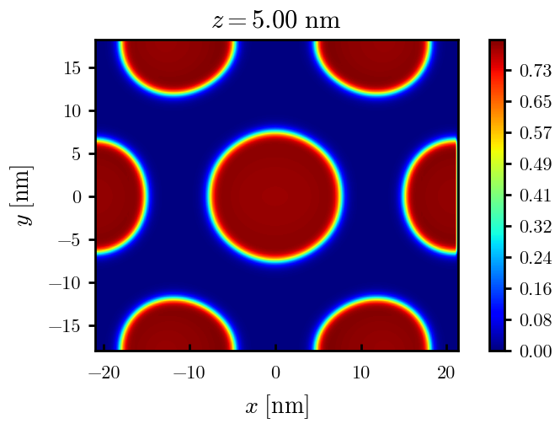
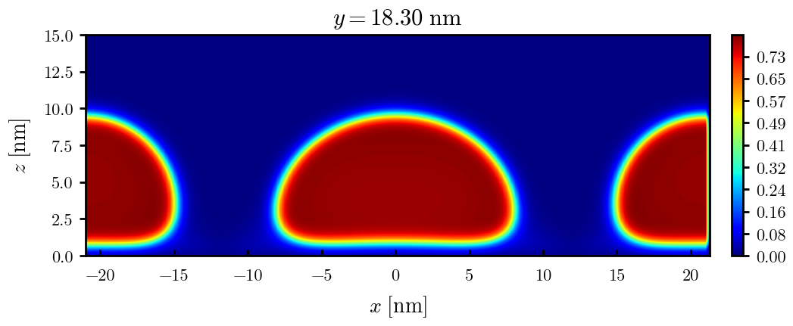
a10s2.5e3
F = -1.45840
F = -1.45357

Slide 11
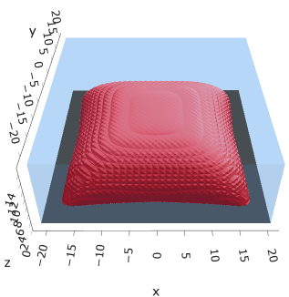
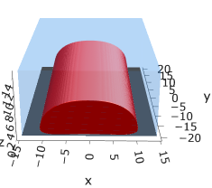
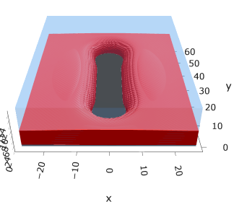
a10s3.75e3
F = -2.19744
F = -2.19763
F = -2.19618

Slide 12
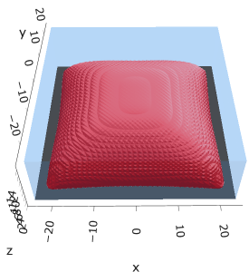


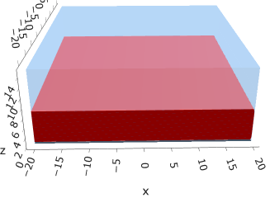


a10s5e3
F = -2.93747
F = -2.93851
F = -2.93859
F = -2.93848

Slide 13
a10s625e3

Slide 14

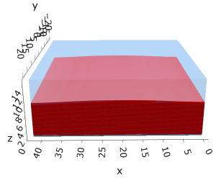

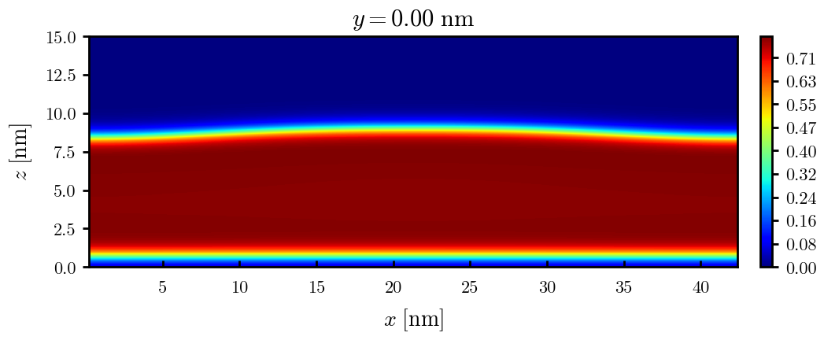
a10s0075
F = -4.42442
F = -4.42465
F = -4.42466

Slide 15


a10s010 - DONE
F = -5.90899
F = -5.90938
Josh tried hole. Unstable

Slide 16
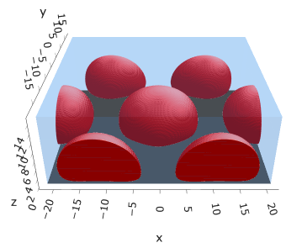
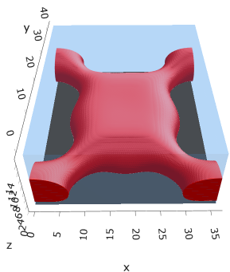

a15s2.5e3
F = -1.43609

Slide 17
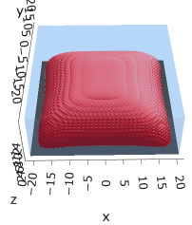



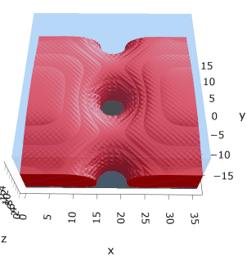
a15s5e3
F = -2.88508
F = -2.88602
F = -2.88654
F = -2.88482

Slide 18
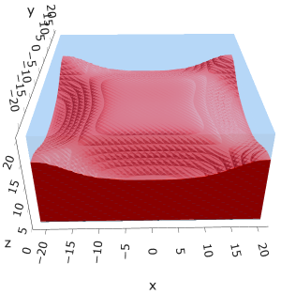

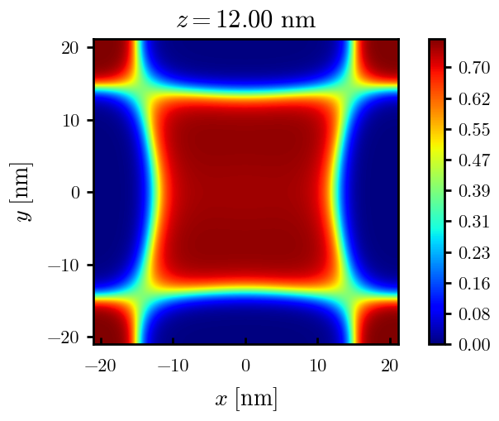
a15s1e2
F = -5.78561
F = -5.78588
Tried hole and didn’t work

Slide 19
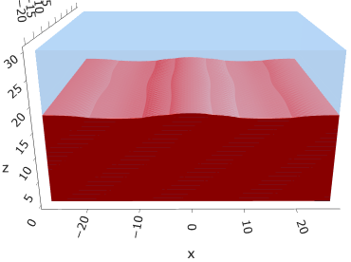
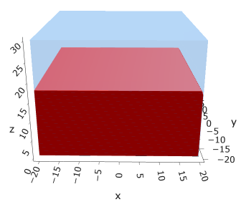
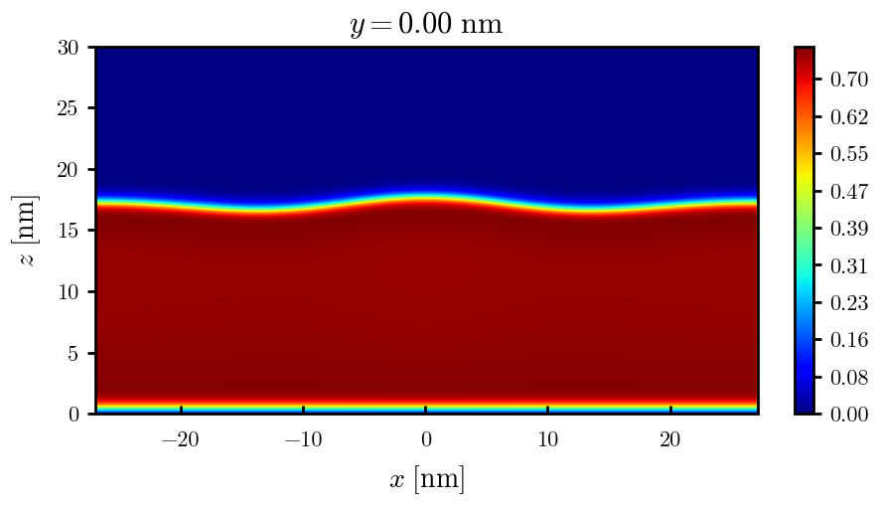
a15s015
F = -8.67754
F = -8.67750

Slide 20
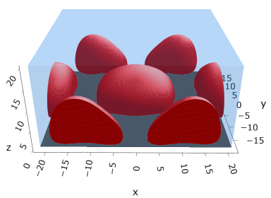
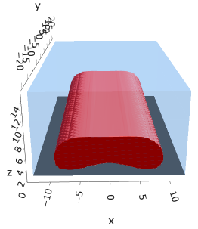
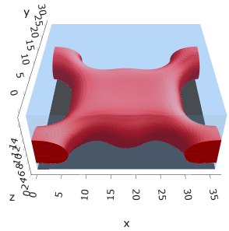
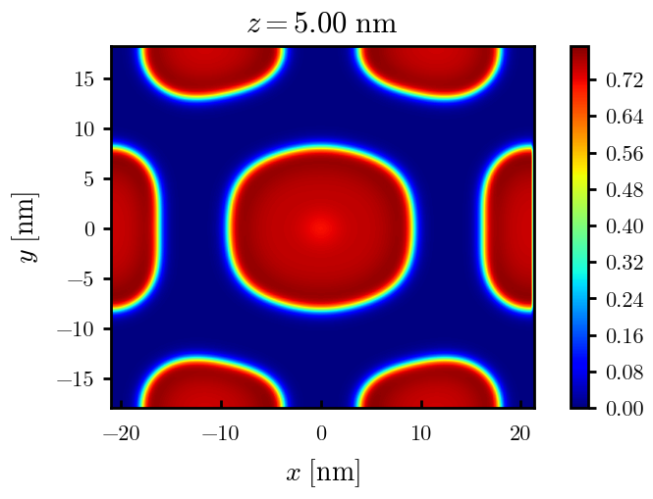
a20s2.5e3
F = -1.41058
F = -1.41046

Slide 21

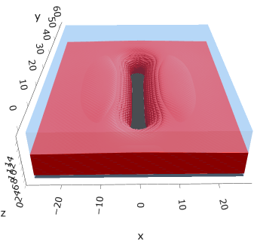
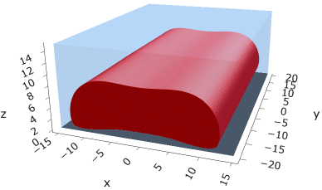
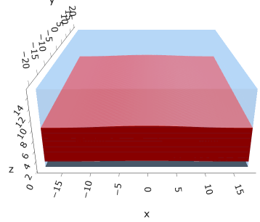
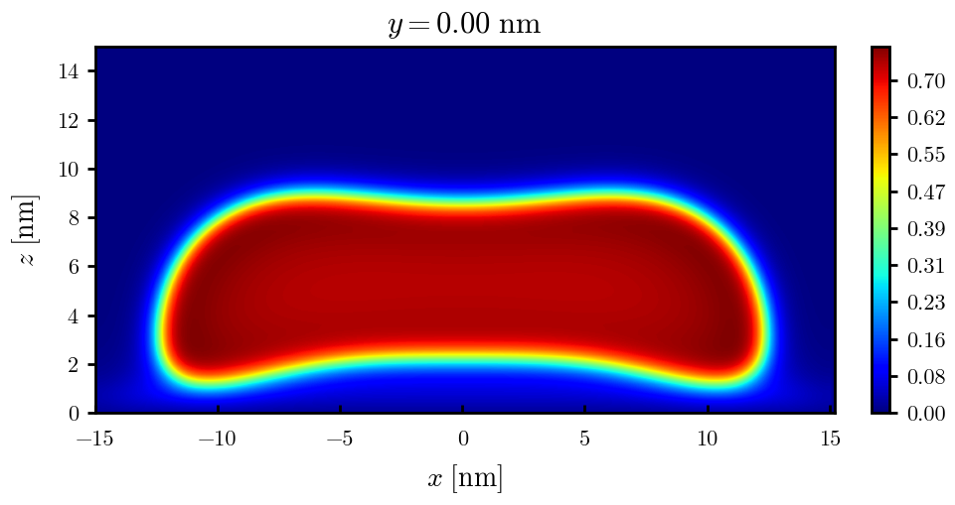
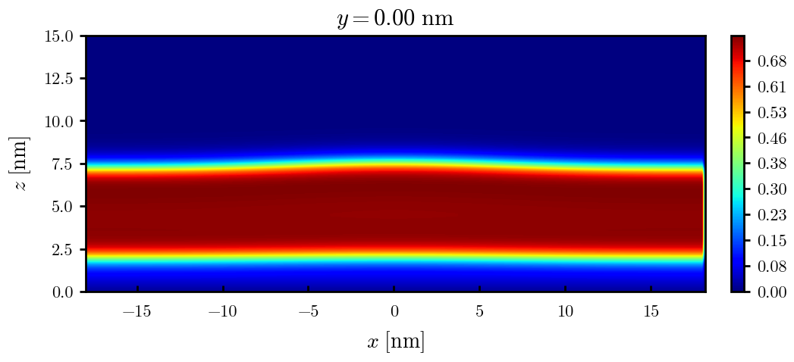
a20s5e3
F = -2.82154
F = -2.82217
F = -2.82208
F = -2.82020

Slide 22
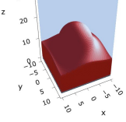
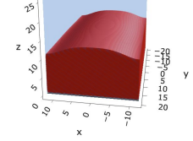
a20s010
F = -5.63481
F = -5.63514

Slide 23


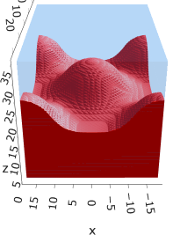
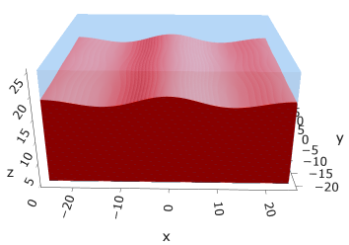
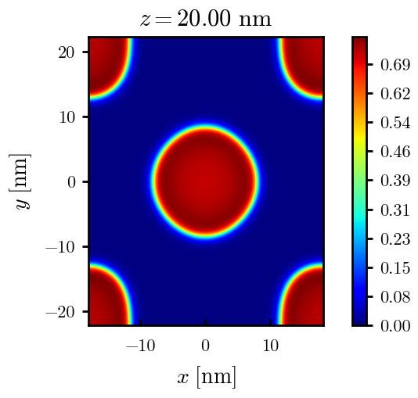
a20s015
F = -8.44011
F = -8.44081
F = -8.43935
F = -8.43930
n_coarse = 2

Slide 24



a20s0175
F = -9.83777
F = -9.83863
F = -9.83859

Slide 25




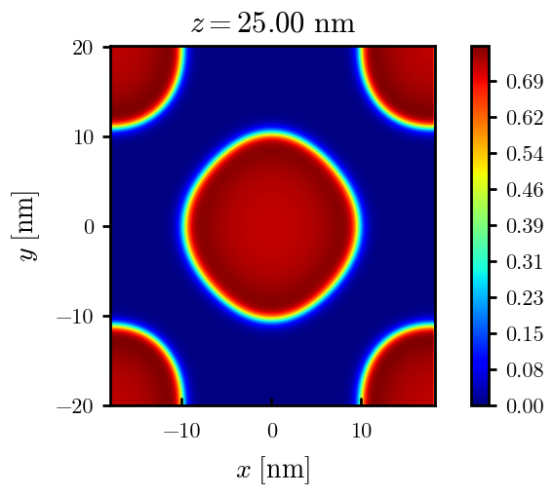
a20s020
F = -11.2312
F = -11.2319
F = -11.2321
n_coarse = 2

Slide 26



a20s022 – DONE
F = -12.3420
F = -12.3429
F = -12.3433

Slide 27




a20s025 - DONE
F = -14.0028
F = -14.0029
F = -14.0033
F = -13.9755

Slide 28




a20s027 - DONE
F = -15.1049
F = -15.1047
F = -15.0898
F = -15.1050

Slide 29
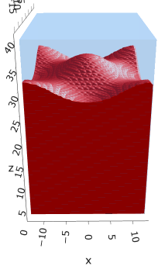
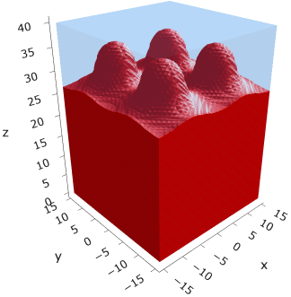
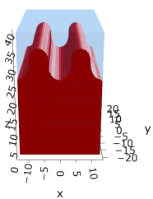
a225s025
F = -13.7769
F = -13.7774
F = -13.7775

Slide 30
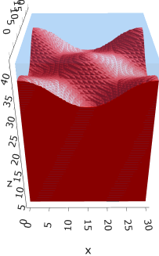
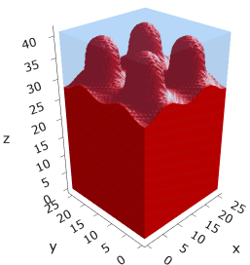
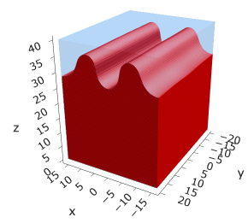
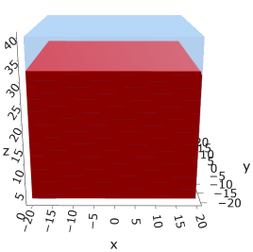
a225s0275
F = -15.1288
F = -15.1293
F = -15.1292
F = -15.1293

Slide 31
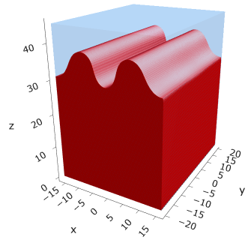
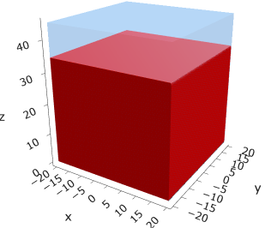
a225s030
F = -16.4742
F = -16.4743

Slide 32
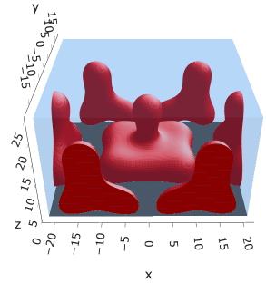
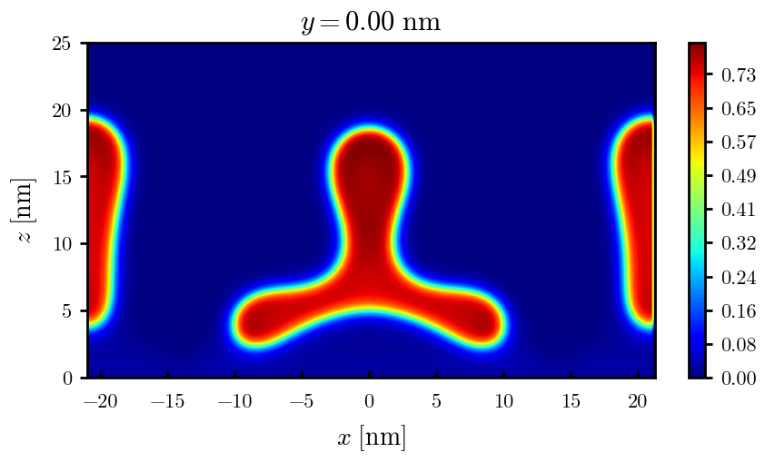


a25s2.5e3

Slide 33
a25s5e3

Slide 34








a25s010
F = -5.47583
F = -5.48308
F = -5.48427
F = -5.48457

Slide 35












a25s015
F = -8.18187
F = -8.17785
F = -8.18516
F = -8.18884
F = -8.18878
F = -8.18865

Slide 36










a25s015 – cyl <> cyl-str
F = -8.18470
F = -8.18421
F = -8.18550
F = -8.18563
F = -8.18589

Slide 37







a25s020
F = -10.8712
F = -10.8748
F = -10.8775
F = -10.8766

Slide 38




a25s025
F = -13.5406
F = -13.5450
F = -13.5463
F = -13.5461

Slide 39






a25s027
F = -14.6059
F = -14.6065
F = -14.6030
F = -14.6015
F = -14.6022
F = -14.6018

Slide 40







a25s030
F = -16.1888
F = -16.1896
F = -16.1896
F = -16.1854
F = -16.1854
F = -16.1858
F = -16.1857

Slide 41






a25s0325
F = -17.4997
F = -17.4998
F = -17.4968
F = -17.4973
F = -17.4971
F = -17.4975

Slide 42




a25s035
F = -18.8025
F = -18.8025
F = -18.8000

Slide 43



a25s040
F = -21.3805
F = -21.3796

Slide 44




a25s045
F = -23.9208
F = -23.9202
F = -23.9000

Slide 45



a30s0025

Slide 46


a30s005

Slide 47

a30s015

Slide 48









a30s020
F = -10.5092
F = -10.5098
F = -10.4996
F = -10.4878
F = -10.4764

Slide 49





a30s025
F = -13.0657
F = -13.0668
F = -13.0548
F = -13.0538
F = -13.0394

Slide 50






a30s030
F = -15.5953
F = -15.5956
F = -15.5886
F = -15.5897
F = -15.5739

Slide 51





a30s0325
F = -16.8494
F = -16.8486
F = -16.8312
F = -16.8491
F = -16.8268
2C isomin = 0.5

Slide 52






a30s035
F = -18.0779
F = -18.0943
F = -18.0948
F = -18.0946
F = -18.0887
F = -18.0782

Slide 53









a30s040
dz =0.15
F = -20.5583
F = -20.5585
F = -20.5582
F = -20.5549
F = -20.5390
F = -20.5384

Slide 54







a30s045
n_coarse = 2
dz =0.15
F = -22.9834
F = -22.9822
F = -22.9788
F = -22.9692
F = -22.9716

Slide 55





a30s050
dz =0.15
F = -25.3647
F = -25.3647
F = -25.3619
F = -25.3553
F = -25.3480

Slide 56




a30s055
F = -27.6992
F = -27.6993
F = -27.6917
n_coarse = 3

Slide 58




a30s020, chi = 1.35
F = -10.3763
F = -10.3644
F = -10.3602
F = -10.3437

Slide 59





a30s040, chi = 1.35
F = -20.3489
F = -20.3492
F = -20.3446
F = -20.3275
F = -20.3219

Slide 60


a325s020
F = -10.2994
F = -10.2821

Slide 61




a35s020
Cyl?
3 “layers”
+1 dilute layer < isomin = 0.1

Slide 62





a35
s10
s12
s15
s18

Slide 63



Parallelization
$$α=0, χ=1.25, N=50, σ=0.02$$
$$α=0, χ=1.25, N=200, σ=0.005$$
$$L_{x}=L_{y}=23, { L}_{z}=15$$
Nth = 12: 500 it, 4.3 hrs
Nth = 8 : 500 it, 6.9 hrs
Nth = 6 : 415 it, 20 hrs (poss. mem bottleneck)

Slide 64







Exercise: Micelle / Stripe
s = 5e-03, N = 50, a = 0.0, x = 1.0
s = 5e-03, N = 75, a = 0.0, x = 1.0
Isosurface at pha = 0.1

Slide 65






a040x170s020

Slide 66






a040x170s010

Slide 67

a040x170s025

Slide 68














a040x170s022

Slide 69










a040x170 seed
See if becomes hex
cyl4-975
cyl4-12
cyl16-975
cyl16-1025
cyl1

Slide 70






a040x170s017

Slide 71












































a040x170s015 seed
Almost done
Almost done

Slide 72

















a040x170s013

Slide 73
















a040x170s010 seed

Slide 74














X200 x170 x130 x120 x100
F = −10.24458
F = − 9.14301
F = −11.0057
F = −10.2429
F = −11.0015
F = −9.63949
F = −10.2461
F = −10.9948
F = − 9.63030
F = −10.2431
F = −10.9953

Slide 75





a040x100 relaxation

Slide 76








































a040x100 seed
old
old

Slide 77


a040x120 relaxation
F = −10.24458

Slide 78





































a040x120 seed
cyl16-850
cyl16-825

Slide 79






a040x130 relaxation

Slide 80




a040x170 relaxation
F = −9.10347
1 neck

Slide 81







a040x200 relaxation

Slide 82










a040x200 seed
Note: not completely converged but stopped for resources

Slide 84


a0.40 x1.70

Slide 85





Zhulina JCP 1998
a = 0.01
0.1 mM
1 mM
May need to init using sine
10 mM
25 mM
Zhulina NVT; current GCE runs at Lz = 20

Slide 86

Carrillo Langmuir 2009

Slide 87

Parallelization

Slide 88
Equations
Quenched average, np, A --> \inf ; np/A → \sigma
Discrete Gaussian chain

Slide 89




Scaling (Alexander—de Gennes brush)
V = 4.2; H = 27.5 – 30.5
V = 2; H = 39 – 45.5

Slide 90







$φ_{p}$: DGC (3D; NxNy=1) vs MDE (1D)
Ns/sigs: dz = 0.10, Ngz_2 = 4$σ$; Chis/bs: dz = 0.25, Ngz_2 = 3.5$σ$

Slide 91


Numericals
Ys
Possibly do Ngz for multiple dzs

Slide 92








3D
Lxy = 1
Lxy = 10
Lxy = 5
Lxy = 15
y-z heatmaps for $φ_{p}$ at constant x

Slide 93





z-FFT vs z-FD (MDE) – REDFT01 xy(z)
Lx = 5, Ly = 5, Lz = 50. s = 0.02. x = 0.75. a = 0.00, N = 50
3D vs 1D (dashed): dz = 0.5, ds = 0.20; dz_1D = 0.113, ds_1D = 0.083
FFT (xyz)
FFT (yz vs pha)
FD (xyz)
FD (yz vs pha)
Diff btw 1D/3D should just be dz, ds, etc.

Slide 94
Specifying Grafted Points

Slide 95
Strategy
2D binary array for surface sites of homogeneously grafted polymer given grafting density, simulation box size, and discretization (and assuming dx = dy)
Fullspace must be periodic on x0 = xL, y0 = yL
Halfspace must be even on xL/2 and yL/2 (overlap of boundary following REDFT00) and periodic on x0 = xL, y0 = yL.
Homogeneous spacing as determined by regular hexagon, where grafting point at centroid of hexagon
In case there are edge effects, try shifting the centroids away from the boundaries of the xy-plane (only did for fullspace)
Make sure no edge effects by comparing results of full FFT with cos FFT

Slide 96
Test conditions
Sigma = 0.05 c/nm2
Lx = 15 nm
Ly = 15 nm
dx = 0.4 nm
Cast in terms of dx (for rounding and PBC for grafting points):
Sigma = 0.0668 c/nm2
Lx = 14.80 nm
Ly = 11.20 nm
(Sigma error decrease with dx)

Slide 97

Padded PBC (Full FFT)
Hexagons drawn for illustration of hexagon approach

Slide 98

Unpadded PBC (Full/Cos FFT)

Slide 99






Other conditions (full and half results overlapped to show match)
s = 0.0241 (20.28%; dx=0.4), Lx, Ly = 12.40, 20.80
s = 0.0208 (4.08%; dx=0.1), Lx, Ly = 12.90, 22.30
s = 0.1332 (11%; dx=0.1), Lx, Ly = 20.50, 20.40

